Slide 1
Welcome to Arabic Level I by Kurzban

Slide 2
Lesson 10: العاشر الدرس
Objectives:
Review letter Mim.
Separate Pronouns
Inquiring about origin.
Practice
Summary
Flash card

Slide 3
Review MIM: Connect the following:
مِ+نْ+ش+ا+رٌ=
حَ+مَ+ا+مٌ=
نَ+جْ+مَ+ةٌ=
رُ+مَّ+ا+نٌ=

Slide 4
Review letter :ha”
هُ+دْ+هُ+دٌ=
مَ+هْ+دٌ=
مُ+نَ+بِّ+هٌ=

Slide 5
دَجاجَة بَيْنَ َبيْت ْ وَرْدَة بِنْتْ شَايْ باب أُخْت قهوة شُروق
Do you know these vocabulary words?

Slide 6
Lesson 10: Separate Pronouns
You use one pronoun if you are referring to a group of women and another when referring to a group of men.
Here is the list: First Person
Pronoun | Meaning
أنا | I ( Ana)
نَحْنُ | We (Nahnu)

Slide 7
Lesson 10: Separate Pronouns
Second Person
Pronoun | Meaning
أنْتَ | you m.s ( Anta)
أنْتِ | you f.s (Anti)
أنْتُما | you f./m., dual (Antuma)
أنْتُم | you m.p., (Antum)
أنْتُنَّ | you f.p., (Antunna)

Slide 8
Lesson 10: Separate Pronouns
Third Person
Pronoun | Meaning
هو | he ( Hua)
هي | she (Hea)
هما | they f./m., dual (Huma)
هم | they m.p., (hum)
هنَّ | they f.p., (Hunna)

Slide 9
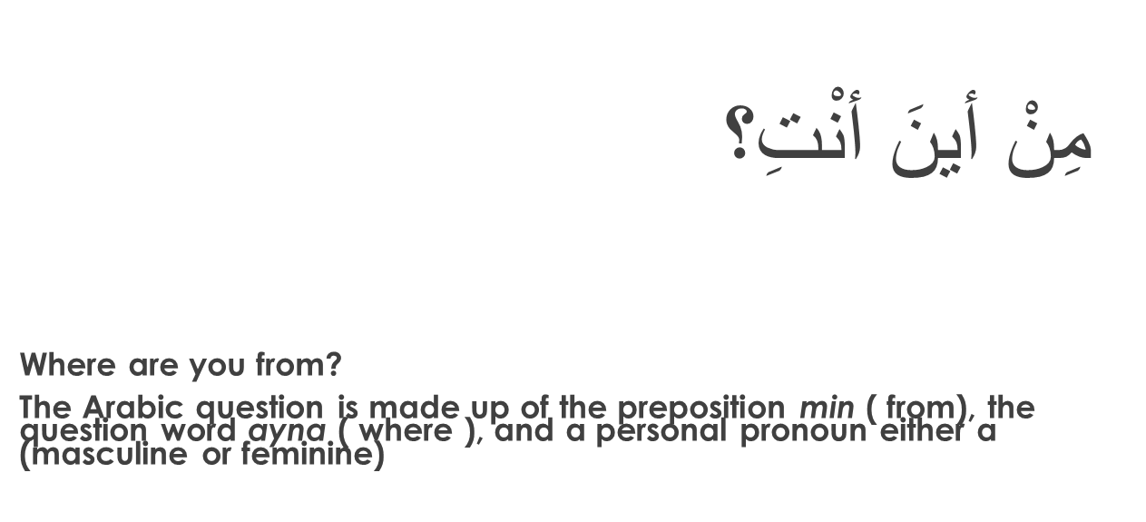
Inquiring about and identifying Place of Origin
Where are you from?

Slide 10
Homework: Connect the following letters:
هَ+ذِ+ه هَ+نَ+ا+ء و أُ+سْ+رَ+تِ+ه+ا
مِ+نْ أَ+يْ+نَ هِ+يَ
فِ+ي مَ+دْ+رَ+سَ+تِ+نَ+ا جُ+بْ+ن

